Slide 1

Purpose of the Project
DE Team

Slide 2

Android App Market
Amr Mohamed
Loay Alaaeldin
Youssef Haitham
Marwan Abdulgawad
Mahmoud Ashmawy

Slide 3

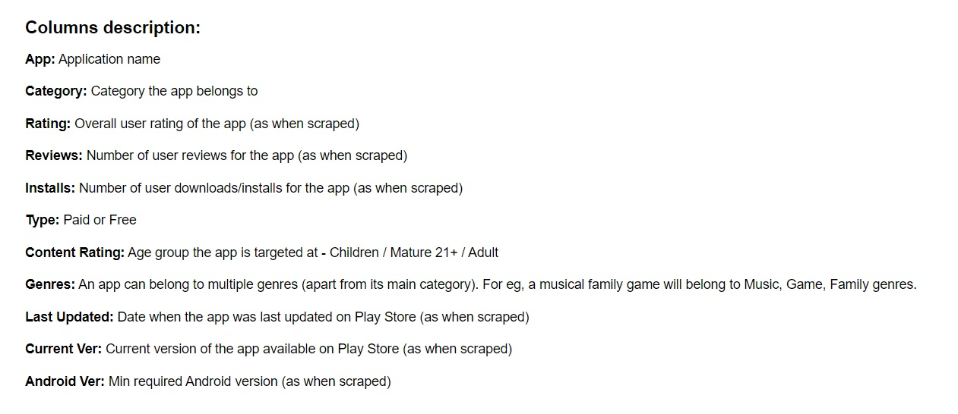
Outline of the dataset

Slide 4
Pipeline
Remove Duplicate Applications
Remove unneeded characters
Convert some columns into numeric
Remove text values in numeric columns
Scale down number of installs and size columns
Convert last updated column into date format
Remove all null values
Apply one hot encoding
Amr Mohamed
Loay Alaaeldin
Youssef Haitham

Slide 5
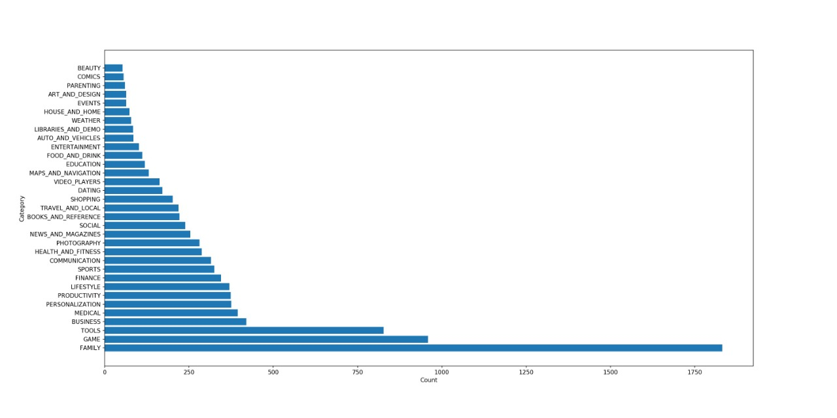
Questions
How many unique categories are in the dataset?
Which of these categories have the fewest number of apps?
Which of these categories have the highest number of apps?
Marwan Abdulgawad
Mahmoud Ashmawy

Slide 6
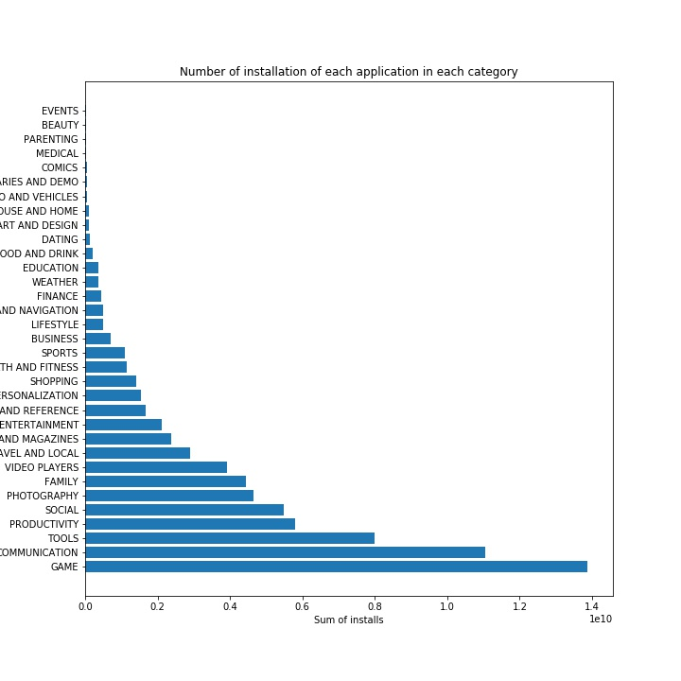
Questions
What type of categories do people mostly install?
Marwan Abdulgawad
Mahmoud Ashmawy

Slide 7
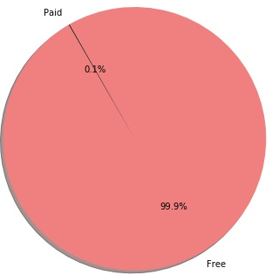
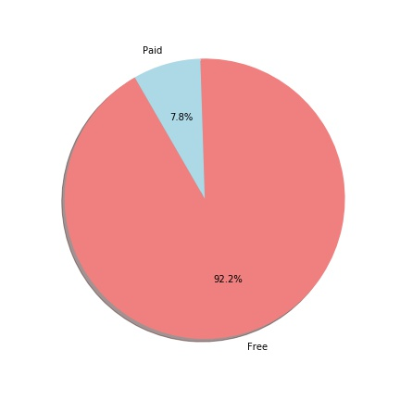
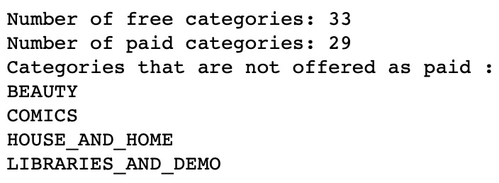
Questions
Which type of apps are mostly downloaded ?
How many free and paid applications?
How many categories contain Free applications only?
Marwan Abdulgawad
Mahmoud Ashmawy

Slide 8
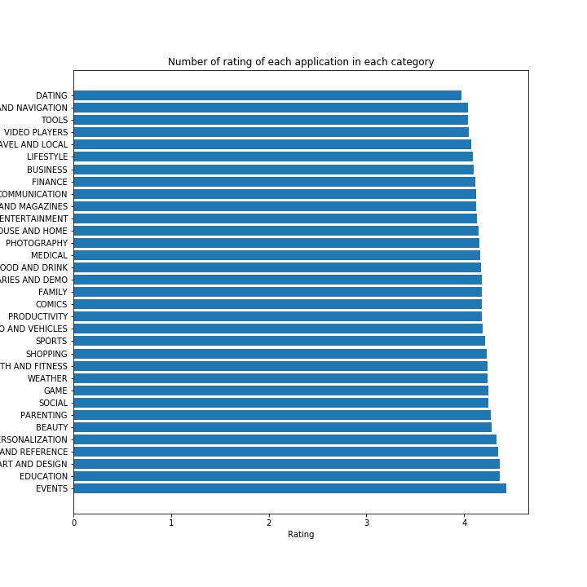
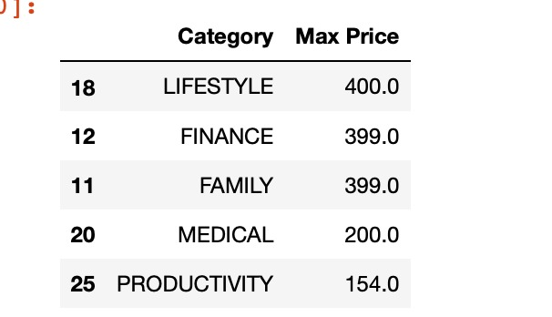
Questions
What are the categories that contain the most expensive apps?
What are the top rated categories ?
Marwan Abdulgawad
Mahmoud Ashmawy

Slide 9
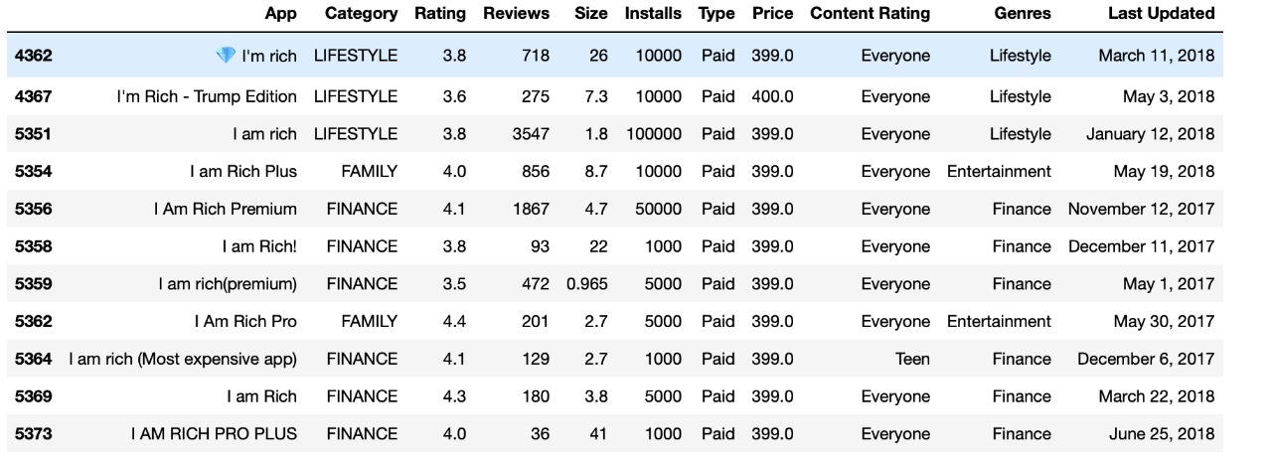
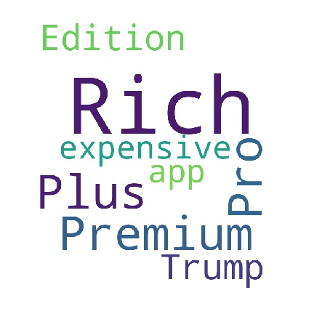
Questions
Which apps in the above categories have the more than 1000 installs?
Marwan Abdulgawad
Mahmoud Ashmawy

Slide 10
Findings
The aforementioned result was expected as the users mostly search for the type of application that entertain them and help them to connect to other people. Another finding is that the percentage of installed free apps is 99.9%, however even this percentage is considered high it might be reasonable to us as we found the percentage of free app in our dataset is 99.2%
33 Categories
Games Communication
Events
Education
Amr Mohamed
Youssef Haitham
Mahmoud Ashmawy
Marwan Abdulgawad
Loay Alaaeldin

